Slide 1
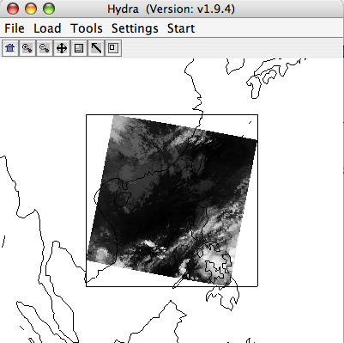
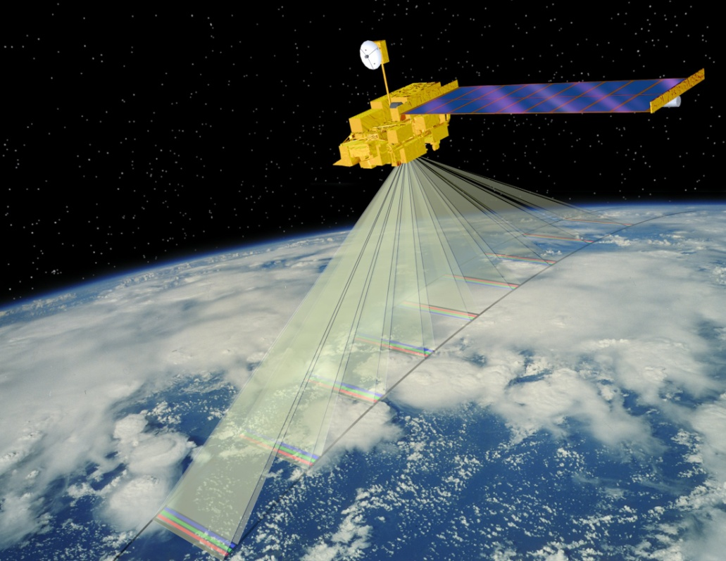


MODIS Sensor Characteristics
& Hydra
Steve Ackerman
stevea@ssec.wisc.edu
Cooperative Institute for Meteorological Satellite Studies
University of Wisconsin-Madison
Notes:
Title slide

Slide 2
Slide Credits
University of Wisconsin-Madison: Paul Menzel, Steve Ackerman, Paolo Antonelli, Chris Moeller, Kathy Strabala, Bryan Baum, Suzanne Seemann.
MODIS Science Team: Michael King, Steve Platnick, Eric Vermote, Robert Wolfe, Bob Evans, Jacques Descloitres, Jack Xiong.

Slide 3
Introduction to Remote Sensing
http://www.ssec.wisc.edu/sose/pirs/pirs_m2_footprint.html

Slide 4
Introduction to Satellite Orbits
http://www.ssec.wisc.edu/sose/pirs/pirs_m1_leo.html

Slide 5
Introduction to MODIS

Slide 6
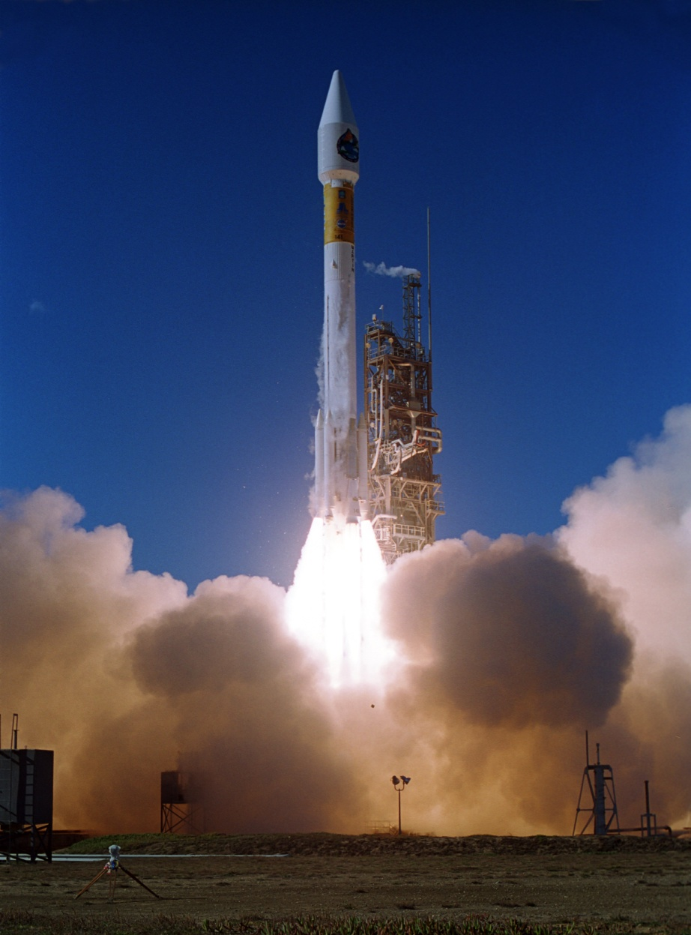

Terra
Launched: Dec. 18, 1999
10:30 am descending
ASTER: Hi-res imager
CERES: Broadband scanner
MISR: Multi-view imager
MODIS: Multispectral imager
MOPITT: Limb sounder

Slide 7
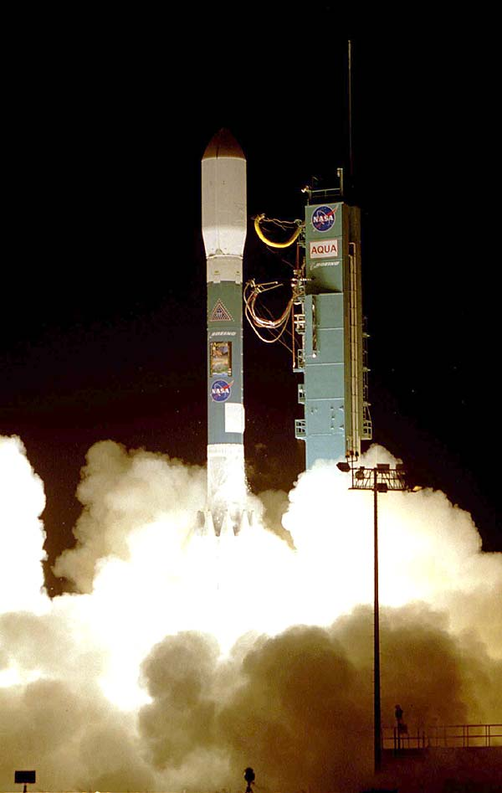
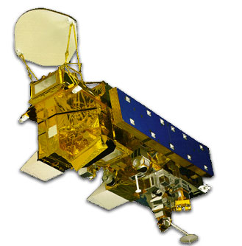
Aqua
Launched: May 4, 2002
1:30 pm ascending
AIRS: Infrared sounder
AMSR-E: Microwave scanner
AMSU: Microwave scanner
CERES: Broadband scanner
HSB: Microwave sounder
MODIS: Multispectral imager

Slide 8
Electromagnetic Energy

Slide 9
Moderate resolution imaging spectroradiometer (MODIS)
Heritage: AVHRR (land), SeaWIFS (ocean), HIRS (atmosphere)
Spectral coverage: 36 bands from 0.4 to 14.2 microns
Spatial resolution: 2 bands @ 250 m; 5 @ 500 m; 29 @ 1000 m
Major differences:
More spectral bands (490 detectors)
Multiple samples along track on each earth scan
Higher spatial resolution
On-orbit radiometric, spatial, and spectral calibration
Improved radiometric accuracy and precision (12-bit)
Improved geolocation accuracy
Higher data rate requiring X-band direct broadcast

Slide 10
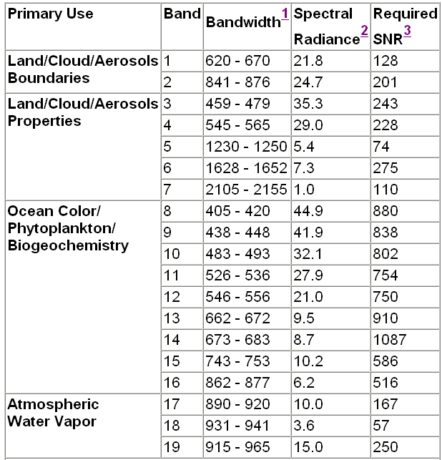
MODIS Reflected Solar Bands

Slide 11
MODIS Thermal Emissive Bands

Slide 12
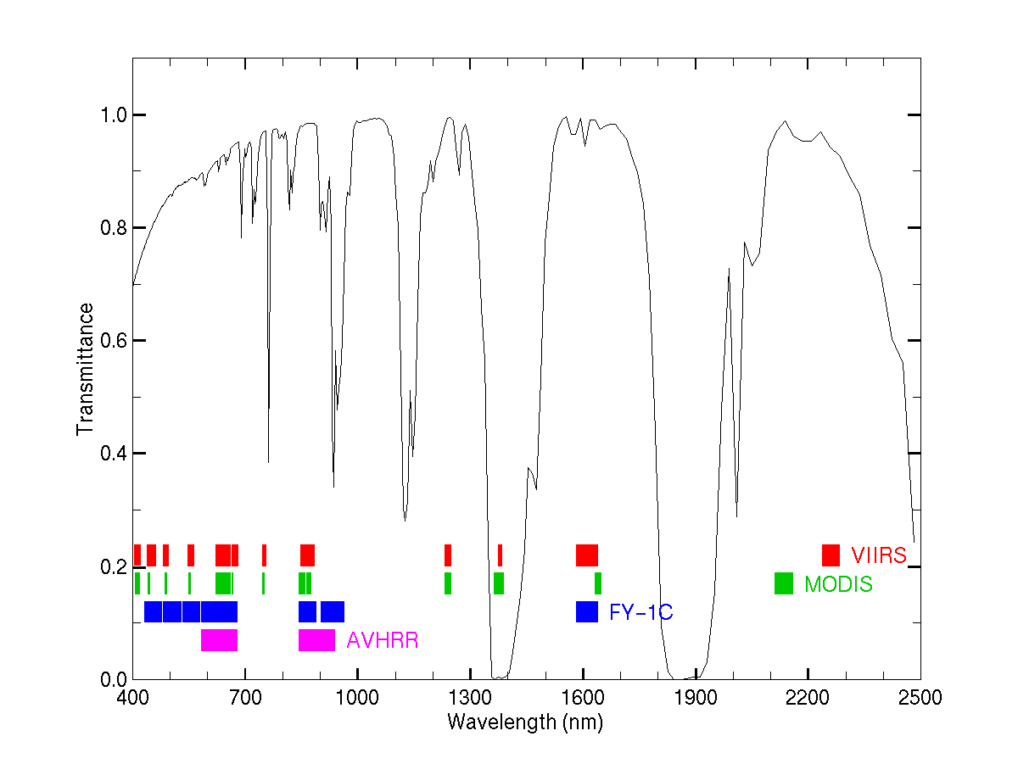
VIIRS, MODIS, FY-1C, AVHRR
CO2
O2
O3
H2O
O2
H2O
H2O
O2
H2O
H2O
H2O
CO2

Slide 13
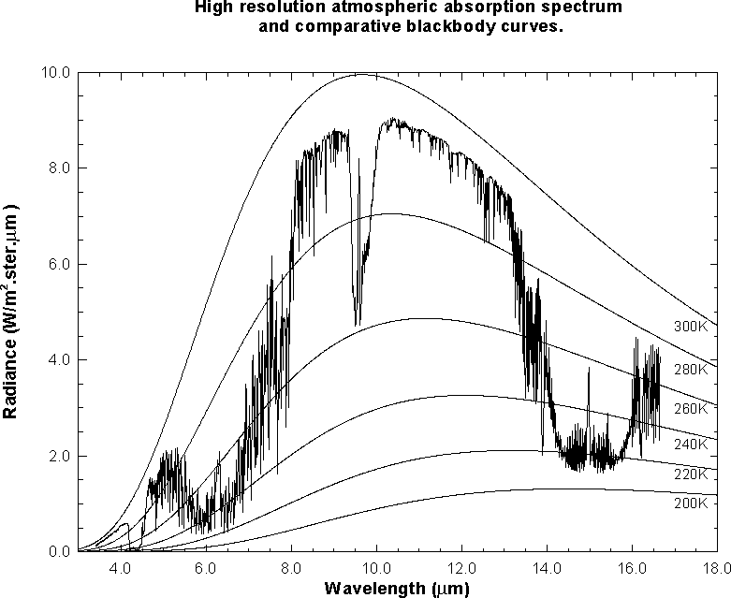
MODIS IR Spectral Bands
MODIS
Notes:
This slide shows an observed infrared spectrum of the earth thermal emission of radiance to space. The earth surface Planck blackbody - like radiation at 295 K is severely attenuated in some spectral regions. Around the absorbing bands of the constituent gases of the atmosphere (CO2 at 4.3 and 15.0 um, H20 at 6.3 um, and O3 at 9.7 um), vertical profiles of atmospheric parameters can be derived. Sampling in the spectral region at the center of the absorption band yields radiation from the upper levels of the atmosphere (e.g. radiation from below has already been absorbed by the atmospheric gas); sampling in spectral regions away from the center of the absorption band yields radiation from successively lower levels of the atmosphere. Away from the absorption band are the windows to the bottom of the atmosphere. Surface temperatures of 296 K are evident in the 11 micron window region of the spectrum and tropopause emissions of 220 K in the 15 micron absorption band. As the spectral region moves toward the center of the CO₂ absorption band, the radiation temperature decreases due to the decrease of temperature with altitude in the lower atmosphere.
IR remote sensing (e.g. HIRS and GOES Sounder) currently covers the portion of the spectrum that extends from around 3 microns out to about 15 microns. Each measurement from a given field of view (spatial element) has a continuous spectrum that may be used to analyze the earth surface and atmosphere. Until recently, we have used “chunks” of the spectrum (channels over selected wavelengths) for our analysis. In the near future, we will be able to take advantage of the very high spectral resolution information contained within the 3-15 micron portion of the spectrum. From the polar orbiting satellites, horizontal resolutions on the order of 10 kilometers will be available, and depending on the year, we may see views over the same area as frequently as once every 4 hours (assuming 3 polar satellites with interferometers). With future geostationary interferometers, it may be possible to view at 4 kilometer resolution with a repeat frequency of once every 5 minutes to once an hour, depending on the area scanned and spectral resolution and signal to noise required for given applications.

Slide 14
MODIS Challenges
Multiple detectors:
Detector differences are noticeable
Dead or out-of-family detectors must be handled
Multiple samples along track introduce bowtie distortion
Spectral information:
Many interdependent bands
How to utilize all the spectral information?
Data rate:
Orders of magnitude larger than heritage sensors

Slide 15
Scanner Characteristics

Slide 16
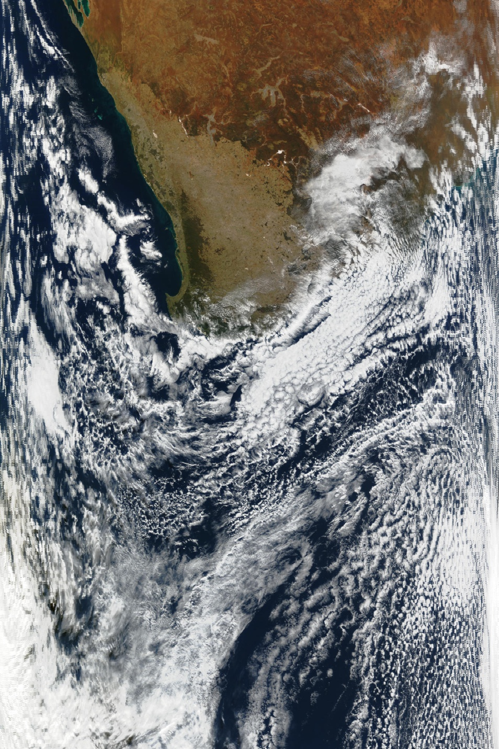
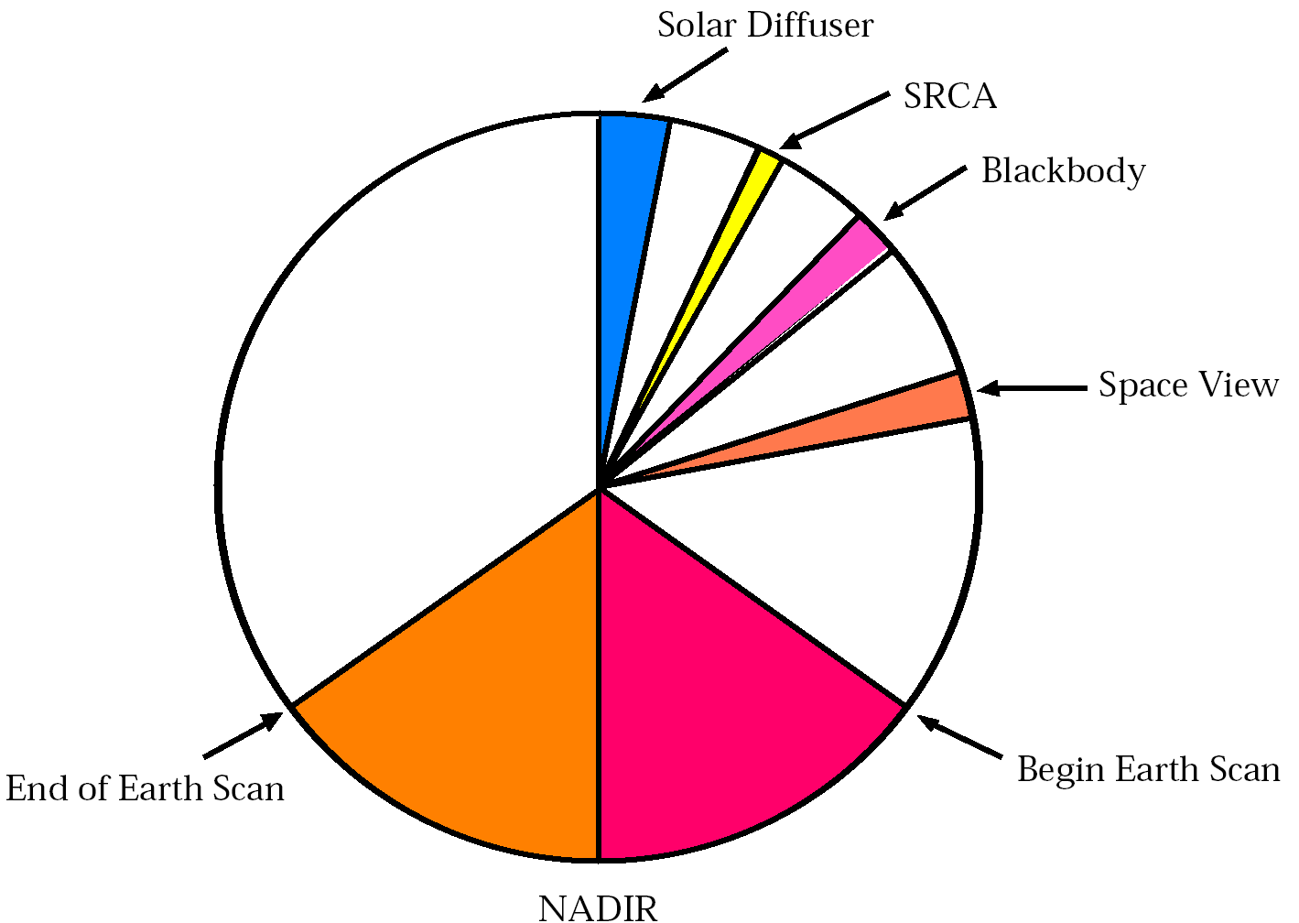
Scan direction
Image Acquisition Details
Scan sequence:
Solar diffuser
Spectroradiometric Calibration Assembly
Blackbody
Space View
Earth scan
Flight direction

Slide 17
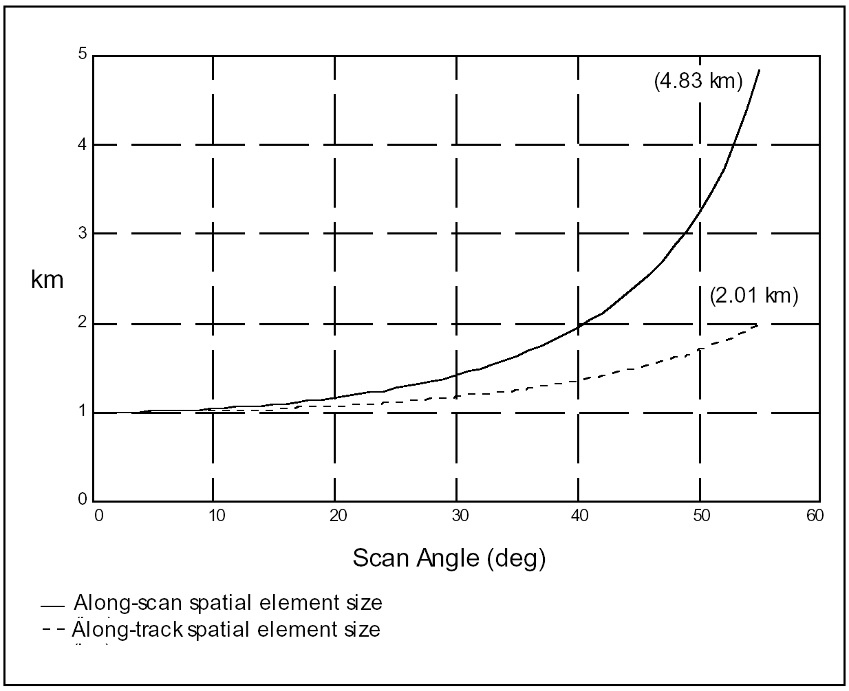
Growth of MODIS 1 km pixel with scan angle

Slide 18
MODIS Bowtie Artifacts
Consecutive “bowtie” shaped scans are contiguous at nadir, and overlap as scan angle increases…

Slide 19
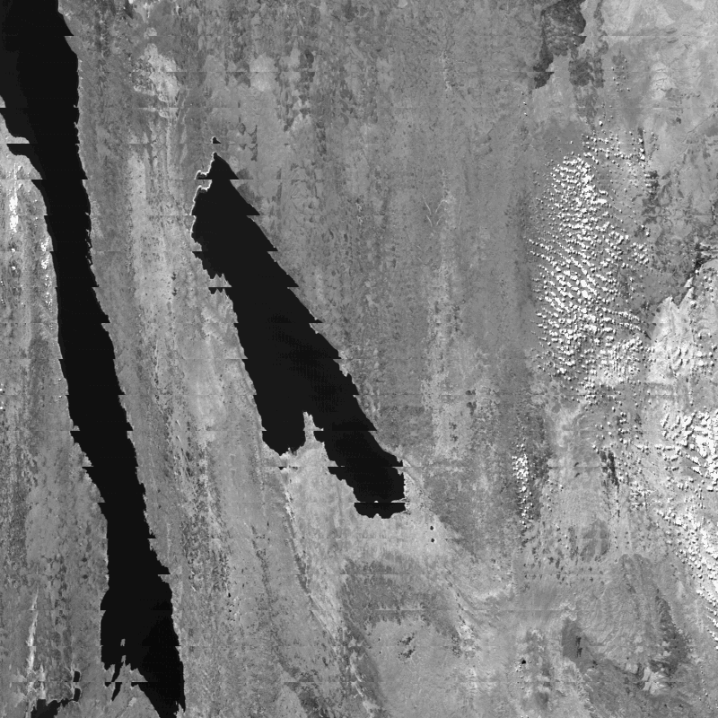
MODIS bowtie artifacts at edge of swath
Band 2 (0.87 micron)
250 meter resolution

Slide 20
Bowtie Artifacts
Are not a ‘problem’: they are a consequence of the sensor design
Can be removed for visualization purposes by reprojecting the image onto a map
Do not affect science algorithms that run on a pixel-by-pixel basis or within one earth scan

Slide 21
Image Artifacts

Slide 22
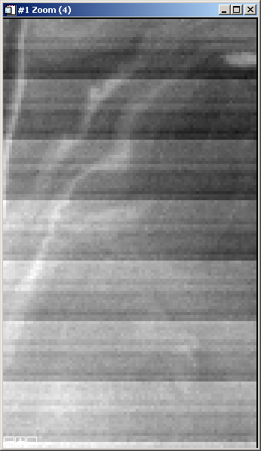
Mirror Side Striping (Band 8, 0.41 μm)
Side 0
Side 1
Reflectance, emissivity, or polarization of each scan mirror side not characterized correctly.
Can be corrected.

Slide 23
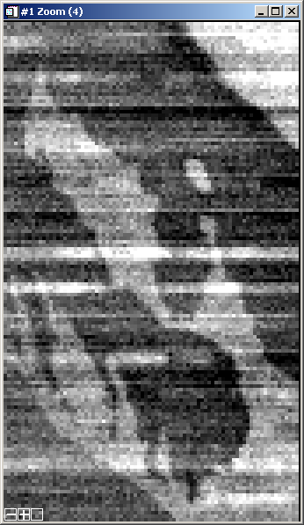
Noisy Detectors (Band 34, 13.6 μm)
Detectors are noisy on a per frame basis and unpredictable from scan to scan.
Difficult to correct.

Slide 24
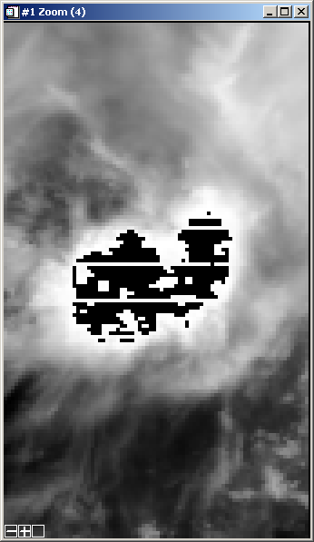
Saturation (Band 2, 0.87 μm)
Signal from earth scene is too large for 12 bit digitization with current gain settings.
Workaround available.

Slide 25
MODIS Performance

Slide 26
MODIS Performance
cont.

Slide 27
MODIS Performance
cont.

Slide 28
Destriping

Slide 29
MODIS Destriping
Striping is a consequence of the calibration algorithm, where each detector is calibrated independently. If the instrument were characterized perfectly, there would be no striping.
However, it is not possible to characterize the instrument perfectly because of time, cost, and schedule constraints.
As a result, striping artifacts are introduced by:
Two-side scan mirror is not characterized perfectly
Detectors behavior can change in orbit (bias, spectral response)
Detectors may be noisy
The challenge is to design a destriping algorithm which is effective, fast, and insensitive to instrument changes.

Slide 30
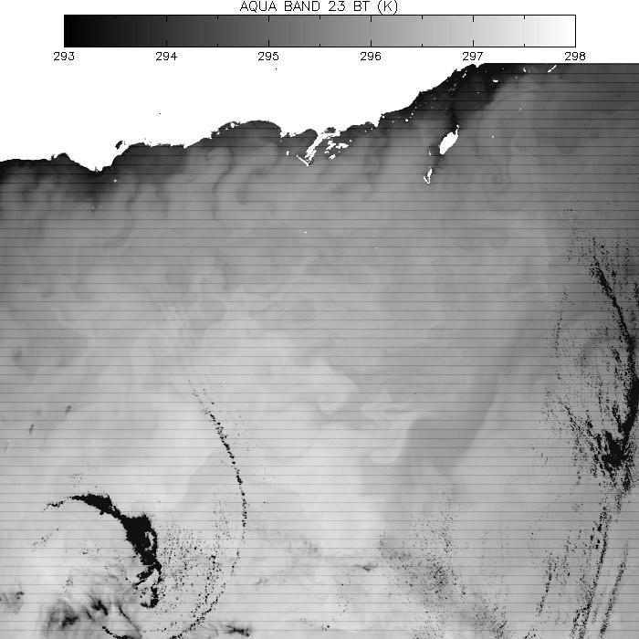

Slide 31


Slide 32
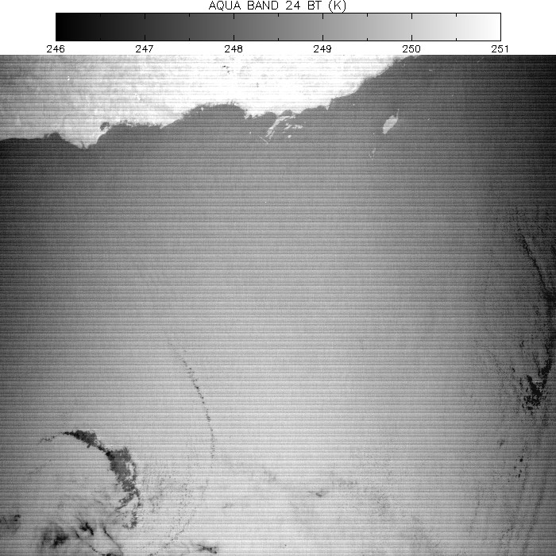

Slide 33
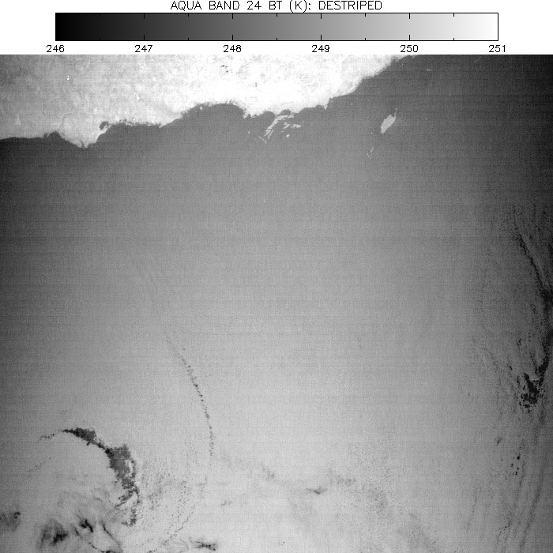

Slide 34
MODIS Emissive Band Destriping: Granule vs. Daily Analysis
The Atmosphere Group products for collection 5 include destriping of all emissive bands (20-25, 27-36) and band 26.
The destriping algorithm is granule-based, and for a small percentage of granules, the impact may be equivocal in bands 31 and 32. Granules with sharp transitions between warm and cool scenes (e.g. hot land, cool ocean) may have artifacts in the scene transition zone.
We analyzed a complete day of data (Terra MODIS 2000337, collection 5) to develop the destriping LUT for bands 31 and 32, with the expectation that sampling a wider range of scenes would remove the artifacts.

Slide 35
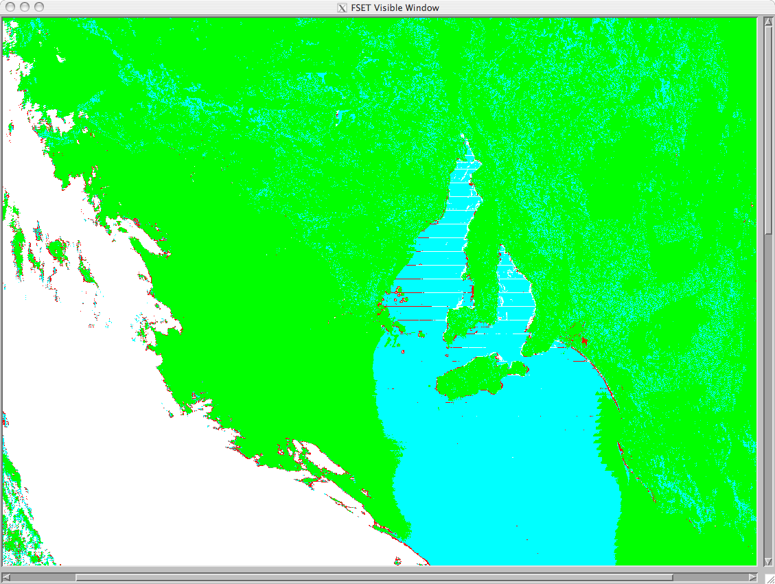
Cloud Mask Final Result, Granule-Based Destriping

Slide 36

Cloud Mask Final Result, Daily-Based Destriping

Slide 37
Getting MODIS data
Go to http://ladsweb.nascom.nasa.gov/data/ This is the data site.
Click on “Search”
Select the Satellite/Instrument, in this case “Aqua/Terra MODIS”.

Slide 38
HYDRA
http://www.ssec.wisc.edu/hydra/

Slide 39
HYDRA
HYDRA - HYper-spectral data viewer for Development of Research Applications - provides a fast and flexible interface that allows users to explore and visualize relationships between passive observations of MODIS and AIRS with the active measurements of the CALIPSO lidar and CloudSat.
HYDRA is a freeware based analysis toolkit for satellite data which has been developed to assist research and development of remote sensing applications as well as education and training of remote sensing scientists.

Slide 40
HYDRA enables interrogation of multispectral (and hyperspectral) fields of data so that
pixel location and spectral measurement values can be easily displayed;
spectral channels can be combined in linear functions and the resulting images displayed;
false color images can be constructed from multiple channel combinations;
scatter plots of spectral channel combinations can be viewed;
pixels in images can be found in scatter plots and vice versa;
transects of measurements can be displayed, and
soundings of temperature and moisture as well as spectra from selected pixels can be compared.

Slide 41
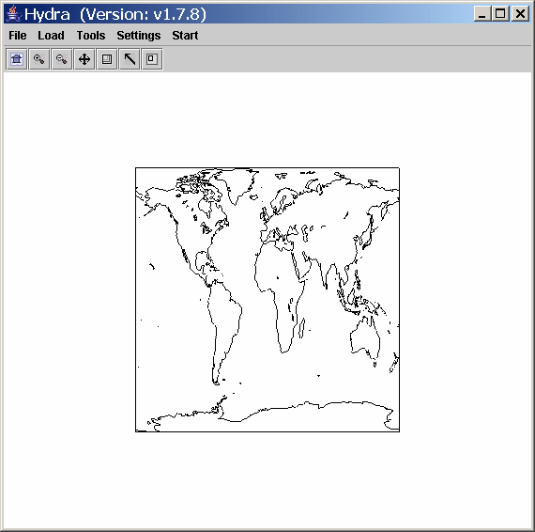
Step 1. Start HYDRA

Slide 42
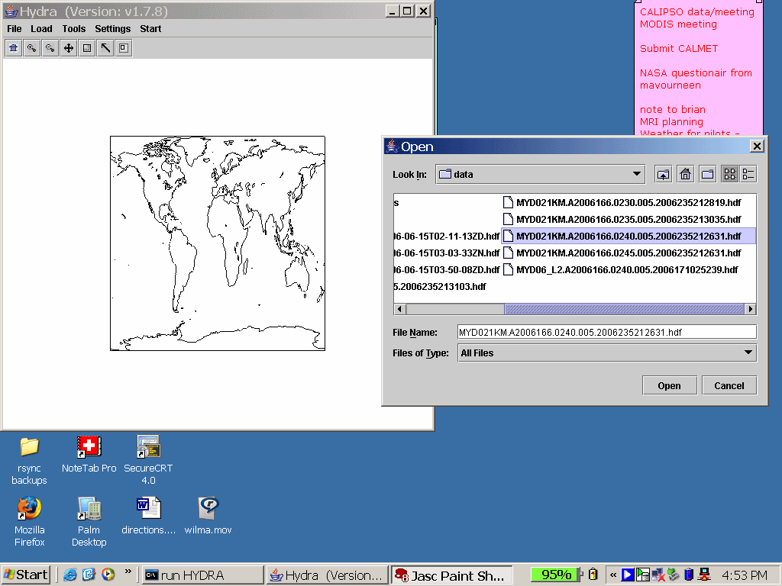
Step 2. Load data, local or on-line. You must load MODIS or AIRS data first.

Slide 43
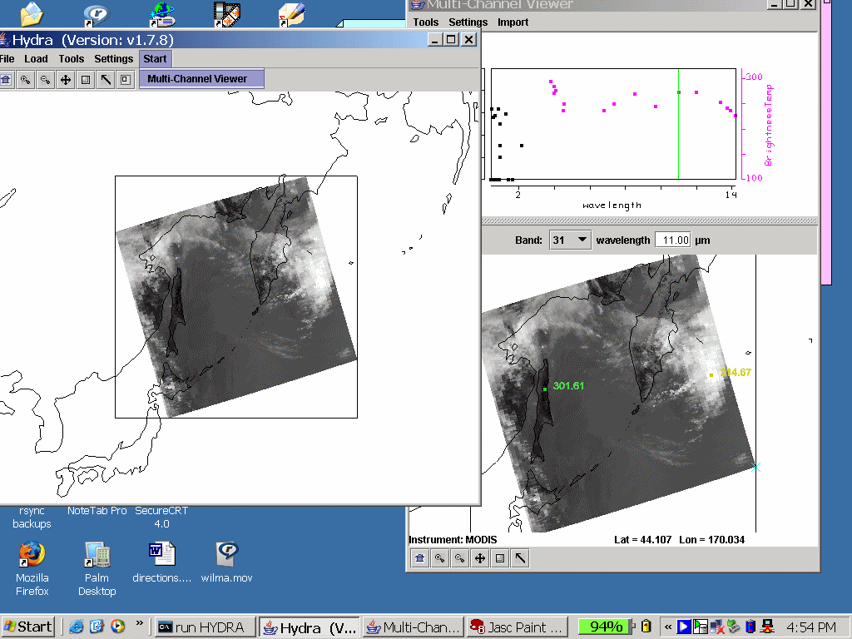
Step 4. Start multi-channel view, MODIS or AIRS data opens Load data, local or on-line. You must load MODIS or AIRS data first.

Slide 44
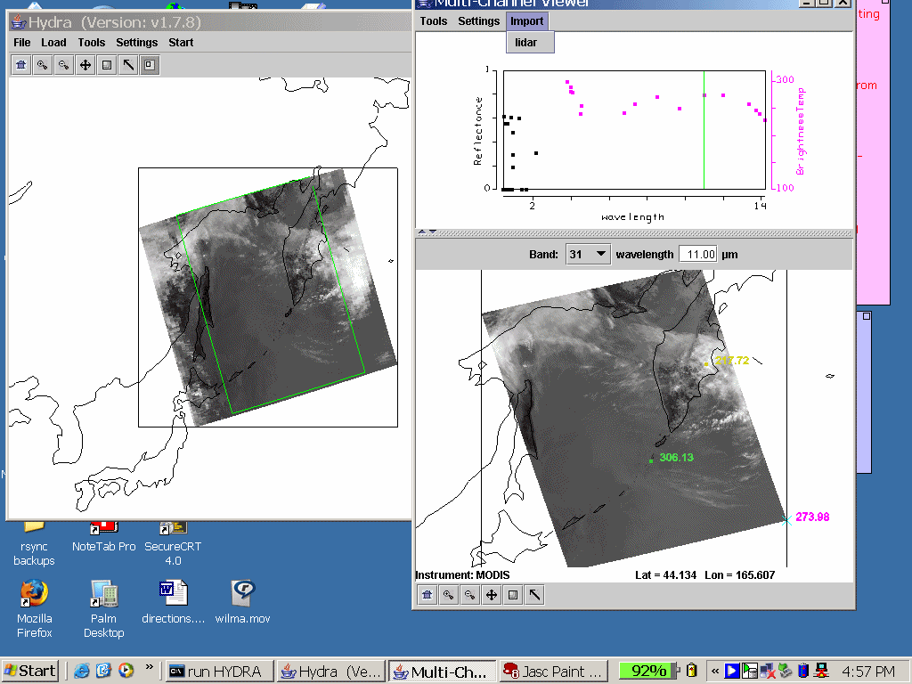
In the Multi-Channel Viewer,
under the Import menu, choose 'Lidar'.

Slide 45
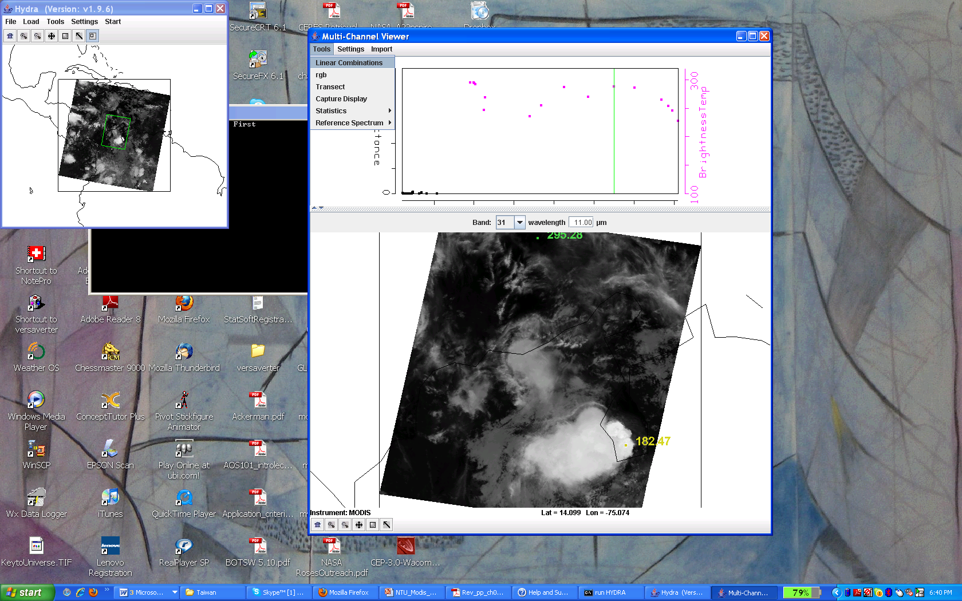
Step 5. Under Tools, Select Linear Combinations from the pop up window

Slide 46
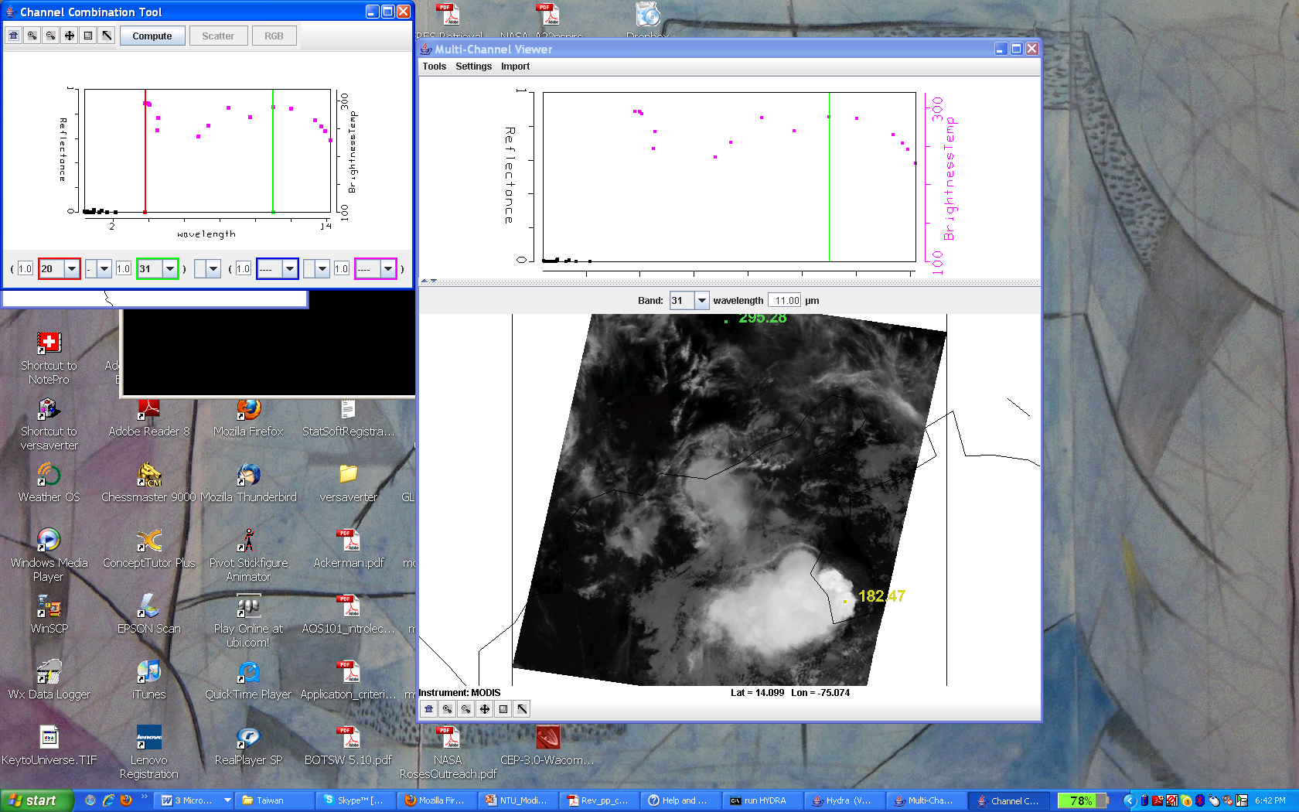
Step 6. Pick new channels, or combination, to view.

Slide 47
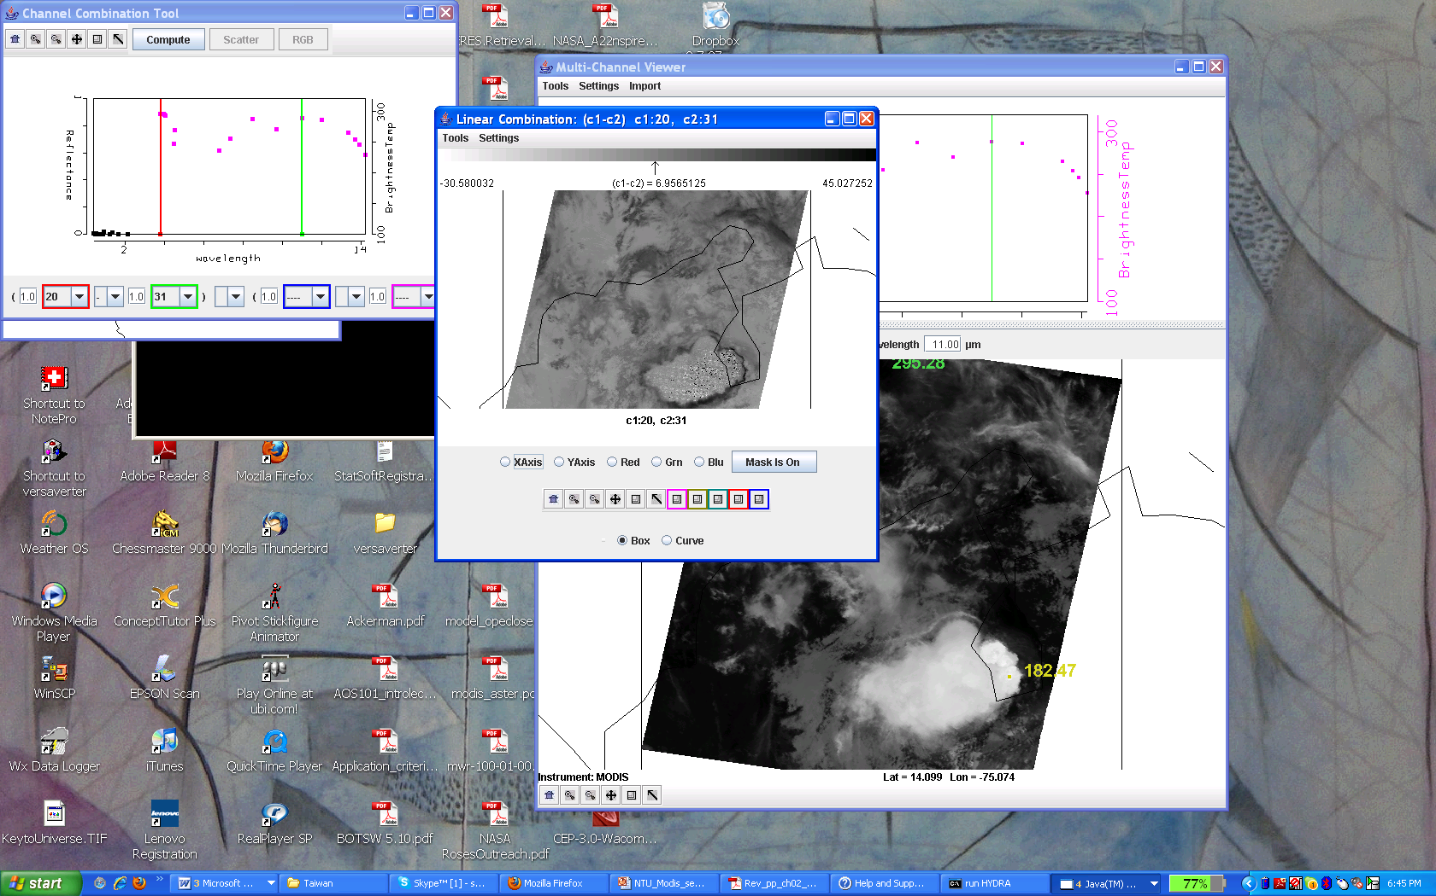
Step 7. New analysis windows open.

Slide 48
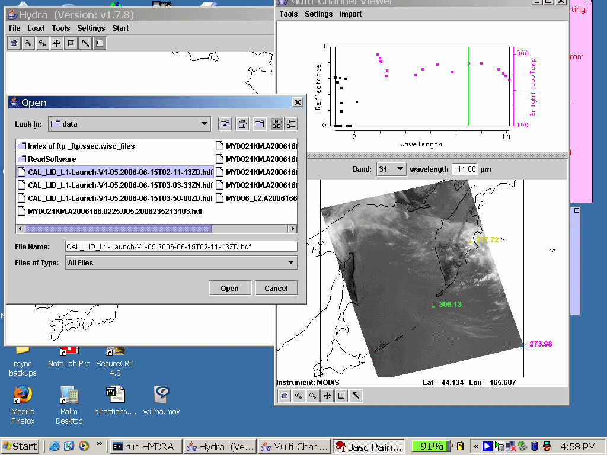
Step 5. Select CALIPSO lidar data set in pop-up window.

Slide 49
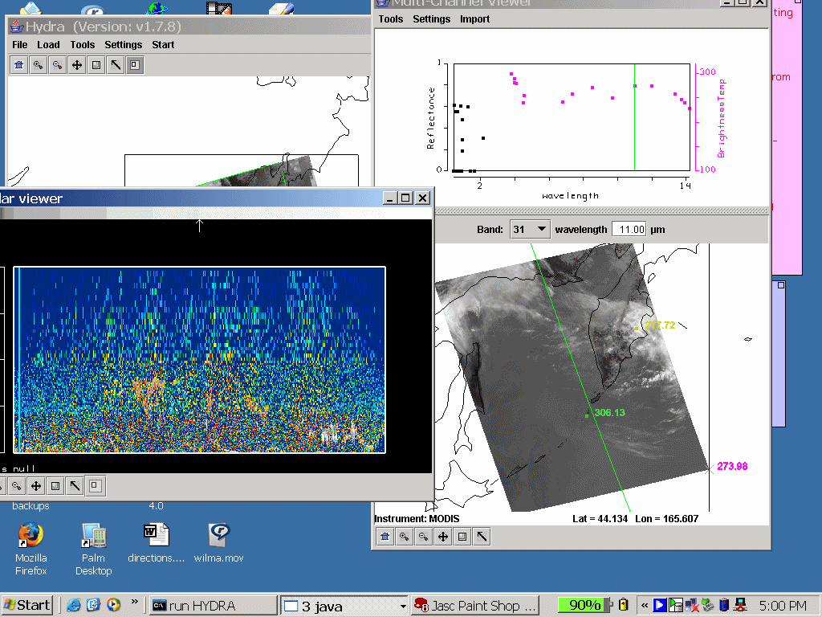
Step 6. Lidar backscatter and polarization appear in a separate window. It is the data from an entire granule, or half and orbit..
Green line show path of CALIPSO satellite.

Slide 50
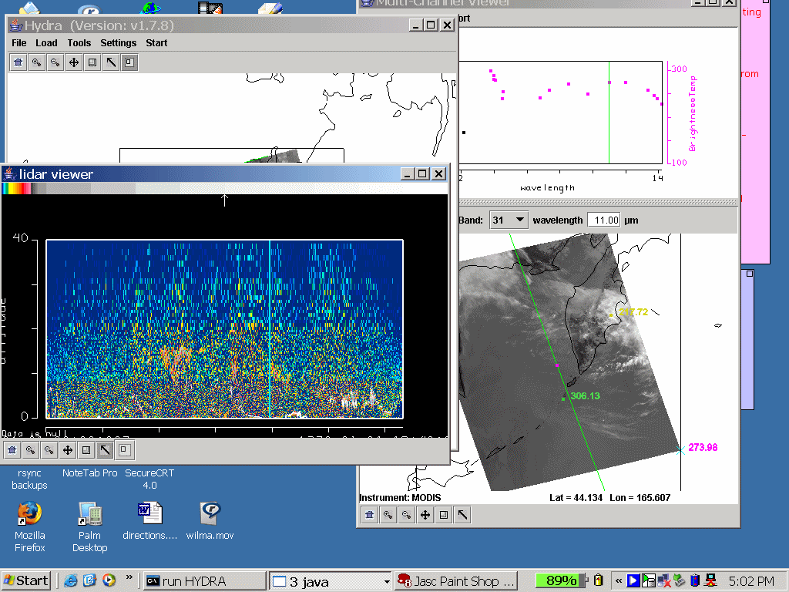
Step 7. Move blue slider bar on lidar cross-section to locate backscatter profile on MODIS scene (see magenta point.)
Green and magenta points on image give value on MODIS image.

Slide 51
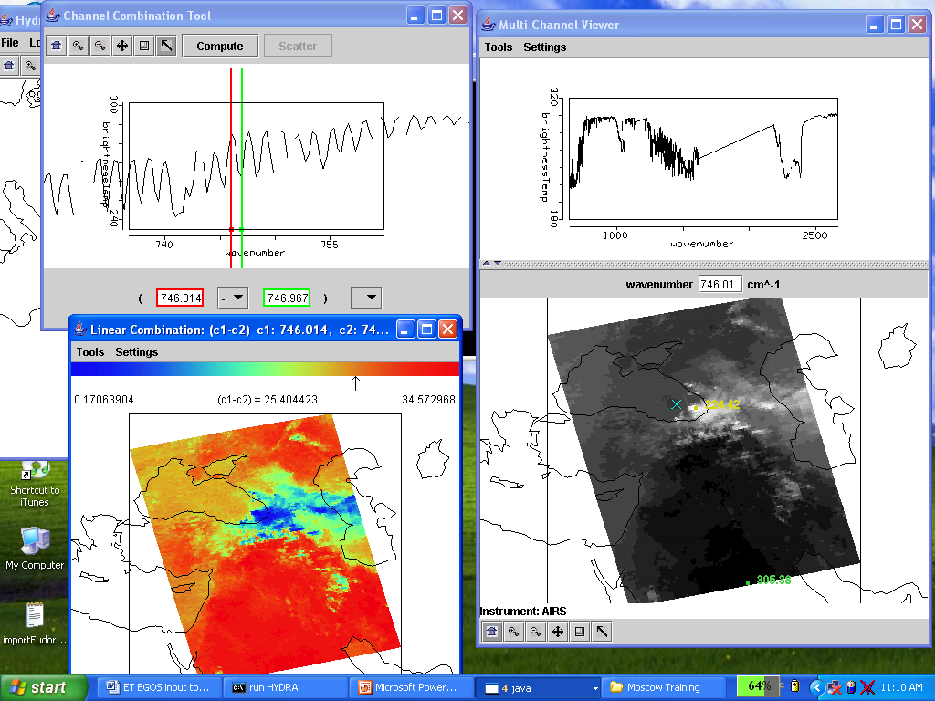
Offline-Online in LW CO2
AIRS Data

Slide 52
Interactive Demonstration

Slide 53
Summary
Hydra is an analysis and visualization tool to explore satellite data sets
Includes (MODIS, AIRS, CALIPSO, CloudSat, AMSU, GOES, AREA files)

Slide 54
For images:
http://earthobservatory.nasa.gov
For animations:
http://svs.gsfc.nasa.gov
For ordering data:
http://echo.nasa.gov

